Slide 1
People Analytics
On
Nursing home

Slide 2
Case Background
All-Staff Survey was conducted at nursing home facility with:
Therapists, Nurses, Social Workers, Admin Support, Managers and Business Support
Survey questions fall in to a particular pattern (Construct)
Team objectives:
Determine if survey questions (variables) are appropriate
Use Factor Analysis to determine:
Distinct Creativity and HR Practice factors
If Creativity and HR Practice factors are inherently different
Determine if/what HR Practices factors enhance Creativity
Notes:
An All-Staff survey was conducted at one our our nursing facilities with various employee types
Therapists, Nurses, Social Workers, Admin Support, Managers and Business Support
The initial survey had wide ranging questions specifically designed to measure a particular construct (questions that fall in to a particular pattern). Initial survey resulted in many constructs.
Our team was assigned to analyze the Creativity and HR Practices constructs:
Creativity - Creativity questions asked participants to rate their performance efforts relative to their coworkers
HR Practices - HR Practice questions asked participants about their thoughts on Unit Leadership
Team objectives are:
Determine if survey questions, Variable Names and descriptions are appropriate measures.
Use Factor Analysis:
To determine distinct Creativity and HR Practice factors
to determine if Creativity and HR Practices factors are inherently different.
Determine if, or what, HR Practices factors enhance Creativity. We ran a regression analysis to tests our hypothesis.

Slide 3
Initial Review
Variable Changes:
Consistency: Utilize EMP### Prefix or Remove
From TEMP to EMPTYPE
From LEVEL to EMPLEVEL
FROM HEXP & TEXP to EXPNH & EXPTOT
Subjective: Remove TENURE question
Eliminate Redundancies in Job Titles:
2 Assistant Nurse Managers
Various Coordinators
Various Managers
Create Job Title Sub-Groups
Admin, Nurses, Therapists, Social Workers, Coordinators, & Office Support
Notes:
We felt the overall structure of the survey questions, Variable Names and descriptions were on par with what our research was trying to accomplish. However, there were a few minor revisions to the Variable Names and Descriptions that we felt would improve the overall survey structure:
Utilize the EMP### for all questions to improve consistency of Variable Names. This would also provide better clarification to anyone trying to interpret results from Variable Names
Remove TENURE question. The Years Expected to stay in this Nursing Home is subjective and can not be quantifiable. For instance, someone can say they intend to be here 10 years, but applying for other jobs as they fill out the survey.
Eliminate Redundancies in the Job Title response scale.
There were 20 positions in the Job Title response scale. Perhaps develop subgroups like Admin, Nurses, Therapists, Social Workers, Coordinators, & Office Support. These subgroups would reduce the description scale and provide larger sample sizes. If we kept the original 20 positions, we would need a fairly large sample size of each position to return a significant result.

Slide 4
Preliminary Assumptions
Mandated Training
*Innovative methods to enhance unit productivity & efficiencies
*Creative ways to improve patient experience
Supervisor/
Employee Engagement
Notes:
Our initial review of the case and questions led us to believe that Mandated Training and Supervisor/Employee engagement would lead to innovative methods to enhance unit productivity and also would lead to creative ways to improve patient experience.
Later on in the presentation, we’ll disclose what our regression analysis determined.

Slide 5
Profile Samples
Do Coordinators or Managers feel they are the most creative with implementing innovative business strategies?
Do Front Line Employees or Managers feel they respond in creative ways to address patient needs?
Which job titles/departments do supervisor/employee engage in meetings to discuss patient needs?
Which employees sign up for unit productivity training versus enhancing medical care?
Notes:
Based on the demographic variables measured, we developed a couple of responding profile samples. These profiles were created before our study findings, so they should not have an affect on the validity of the study findings.
However, should our study findings determine which HR Practices influence Creativity, we could develop a sample profile to enhance our confidence in the data.
For example, if we determine that the HR Practice of Supervisors and Employees openly discussing issues related to patient care lead to implementing new ideas to patient care and satisfaction. We can analyze our study finding to determine Nurse Managers and RNs openly discuss new ideas that lead to implementing improvements in the patient experience

Slide 6
Exploratory & Confirmatory Factor Analysis
Exploratory Factor Analysis:
Use EFA to determine how many factors to extract
An exploratory factor analysis aims at exploring the relationships among the variables
Use CFA to determine how
A confirmatory factor analysis assumes that you enter the factor analysis with a firm idea about the number of factors you will encounter, and about which variables will most likely load onto each factor.
Create sub-dimensions
Test our theories and hypothesis
Since we are exploring the relationships between the variables, We are implementing exploratory factor analysis for analytical design.
Notes:
Our team plans to use EFA to determine how many factors to extract for each component (Creativity and HR Practices). If we did not know our components, we would use EFA to determine components as well.
After we determine how many factors, we’ll use CFA to see how our items load in to each factor, determine if we can create sub-dimensions and also test our theories and hypothesis

Slide 7
Factor Analysis
Creativity Factor Analysis
 | Factor
 | 1 | 2
Creat1 | 0.817
Creat2 | 0.901
Creat3 | 0.987
Creat4 | 0.943
Creat5 | 0.839
Creat8 |  | 0.856
Creat9 |  | 0.949
Creat10 |  | 0.976
HR Practices Factor Analysis
 | Factor
 | 1 | 2
HR1 |  | 0.649
HR2 |  | 0.773
HR3 |  | 0.953
HR4 | 0.911
HR5 | 0.776
HR6 | 0.906
HR11 | 0.690
HR12 | 0.716
Notes:
The data is suitable for factor analysis.
We ran a Principal Axis Factoring to determine how our factors were loading.
The results were as follows:
The Analysis determined:
The Creativity Analysis had two distinct factors:
Creativity questions 1 - 5 and Creativity questions 8 - 10
The HR Practices also had two distinct factors:
HR Questions 1 - 3
HR Questions 4 - 6 & HR 11-12
Combining the factor analysis with our interpretation of the the questions, we decided to create 2 subdimensions for the Creativity and HR Practices components. We named the Creativity subdimensions as Improve Patient Experience and Innovating Business Efficiencies. We named the HR Practices sub-dimensions as Unit Productivity Training and Supervisor/Employee Engagement. The following slides show which items fit in each sub-dimension.

Slide 8
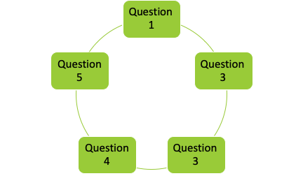
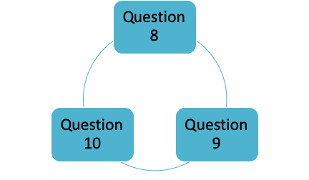
Creativity Subdimensions
Innovating Business Efficiencies
Improve Patient Experience
Notes:
From our factor analysis we learned that, improving business efficiency and patient experience by using innovative methods are the two ways which makes an employee creative.
We can further analyze, how each individual can come about improving their daily tasks and work more efficiently
Also, we can conduct a survey that gives us specific details from each patient regarding their experience.
At this point, further analysis is required

Slide 9
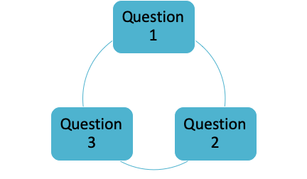
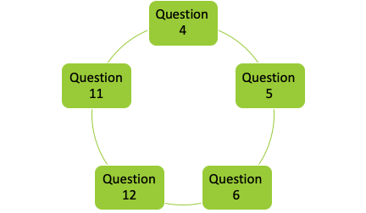
HR Practice Subdimensions
Unit Productivity Training
Supervisor/Employee Engagement

Slide 10
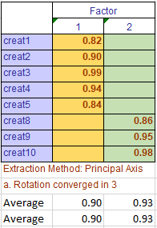

Convergence & Discriminative Validity Test
Creativity Factor Analysis
Most of the values are over 0.7 which makes them convergent.
Since average variance extracted by both factors is higher than the variance shared between them, there is evidence of discriminant validity.
Similarly, for HR practices factor analysis, there is evidence of discriminant validity.
Correlation Matrix
Pattern Matrix
Avg Variance Shared = 0.672*0.672 = 0.452

Slide 11
Conclusion based on factor analysis
The factors that influence creativity are questions regarding innovating business efficiencies and improving patient experience.
On the other hand, unit productivity training and supervisor/employee engagement influences Hr practises.
Suggestions:
Managers should guide employees on how they can do their tasks more efficiently.
CEO’s should optimize training programs which induces more productivity and efficiency. Also, by guiding the managers on the meetings with their respective employees working under them.
Nursing home workers should focus on making sure the patients are comfortable and their basic needs are taken care of.
Public policy officials can improve patient experience by keeping paperwork to a minimum.

Slide 12
Hypothesis Test (BusinessEfficiencies)
HR Factor 1 Null Hypothesis – Unit Productivity Training does not influence Business Efficiencies
HR Factor 1 Research Hypothesis – Unit Productivity Training does influence Business Efficiencies.
HR Factor 2 Null Hypothesis – Supervisor/Employee Engagement does not influence Business Efficiencies
HR Factor 2 Research Hypothesis – Supervisor/Employee Engagement does influence Business Efficiencies.
Notes:
As we previously explained we find 2 HR Practices subdimensions, which is Unit Productivity Training and Supervisor/Employee Engagement and 2 Creativity subdimensions (Business Efficiency and Patient Experience ) from factor analysis.
Then we ran Hypothesis test to determine impact of HR practices factor on creativity factor. And tried to identify which HR factor influences the creativity of nursing home employees.
So , let me quickly explain what is hypothesis test,
Hypothesis testing is a statistical method that is used to identify statistical significance based on test statistics generated in a test. We have used here Hypothesis Tests with Linear Regression. This test checks the significance of individual regression coefficients.
To design a Hypothesis test , we create null hypothesis and research hypothesis.
In the first hypothesis test shown here, we have “Business efficiencies” as dependent variable and Unit Productivity Training as independent variable. So out Null Hypothesis is “” and research hypothesis is “”. Same way we have another test setup for Supervisor/Employee Engagement .
As shown here, we created the first Hypothesis test to identify impact of 2 HR subdimensions Unit Productivity training and Supervisor/Employee Engagement on Business Efficiencies.
For example, we created our Null Hypothesis as “” and alternate hypothesis as
And similar kind of test for supervisor/employee engagement

Slide 13
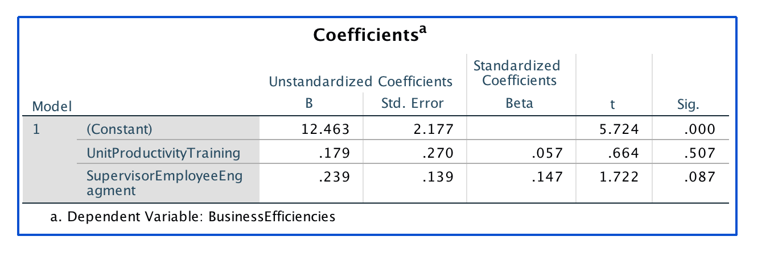
Hypothesis Test Result (BusinessEfficiencies)
Notes:
Here is the result of the first Hypothesis test to validate impact of HR practices sub-dimension on Business Efficiency.
Here, the p-value of Unit Productivity Training is 0.507, which is greater than p value of 0.05, we fail to reject the null hypothesis and conclude that Unit Productivity Training does not influence Business Efficiencies.
Also, the p-value of Supervisor/Employee Engagement is 0.087, which is also greater than 0.05, we fail to reject the null hypothesis and conclude that Employee Engagement does not influence Business Efficiencies.

Slide 14
Hypothesis Test (PatientExperience)
HR Factor 1 Null Hypothesis – Unit Productivity Training does not influence Patient Experience.
HR Factor 1 Research Hypothesis – Unit Productivity Training does influence Patient Experience.
HR Factor 2 Null Hypothesis – Supervisor/Employee Engagement does not influence Patient Experience
HR Factor 2 Research Hypothesis – Supervisor/Employee Engagement does influence Patient Experience
Notes:
Now, this is the second set of hypothesis test that we ran. This one is to determine impact of HR practices sub-dimension unit productivity training and Supervisor/Employee Engagement on Patient Experience.
We created the null hypothesis and alternate hypothesis same as previous test.

Slide 15
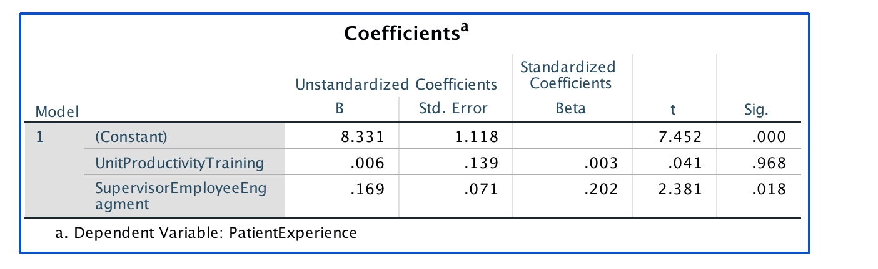
Hypothesis Test Result (PatientExperience)
Notes:
And these are the result of second set of hypothesis test.
Here, the p-value of Unit Productivity Training is 0.968, which is greater than 0.05, we fail to reject the null hypothesis and conclude that Unit Productivity does not influence Patient Experience.
However , the p-value of Supervisor/Employee Engagement is 0.018, which is less than 0.05, we have enough evidence to reject the null hypothesis and conclude that Supervisor/Employee Engagement does influence Patient Experience.

Slide 16
Conclusions
Supervisor/Employee Engagement is significant factor (p=0.018<0.05) impacting Patient Experience. The coefficient is positive (0.169) which would indicate that higher Supervisor/Employee Engagement makes Patient Experience better.
Supervisor/Employee Engagement does not impact Business Efficiencies. (statistically insignificant p = 0.087>0.05)
UnitProductivityTraining does not affect Patient Experience as well as Business Efficiencies.
Most Significant HR Practices Factor :- SupervisorEmployeeEngagment
Notes:
So , Here are some of the conclusions we drawn from the Hypothesis tests.
Supervisor/Employee Engagement is significant factor (p=0.018<0.05) impacting Patient Experience. The coefficient is positive (0.169) which would indicate that higher Supervisor/Employee Engagement makes Patient Experience better.
However, Supervisor/Employee Engagement does not impact Business Efficiencies at all. (As it is statistically insignificant p = 0.087>0.05)
In terms of other HR subdimensions factor,UnitProductivityTraining does not affect Patient Experience as well as Business Efficiencies.
So, we can conclude SupervisorEmployeeEngagment as Most Significant HR Practices Factor.
The positive coefficient for Supervisor/Employee Engagement is 0.169 meaning that for a one unit increase in Supervisor/Employee Engagement, we would expect a 0.169-unit improvement in patient experience.

Slide 17
Business Recommendations
Managers and Supervisors should consider increasing meetings with employees to ensure improvement in patient experience.
Keep encouraging employees by giving them constructive feedbacks on their ideas and also empower them in implementing their ideas, which brings innovative practices to improves patient satisfaction.
For Managers
Notes:
We determined that the Supervisor meetings with employees to discuss and gauge patient satisfaction will produce innovative and creative ideas that will result in positive patient satisfaction. The supervisor empowers the employees by implementing their inputs and induces creative ideas.
Managers and Supervisors should consider increasing meetings with employees to ensure improvement in patient experience.

Slide 18
Business Recommendations
Shift the focus of HR training onto improving mentorship skills for supervisors and improving communication between supervisors & employees.
Company should continue investing money on improving Supervisor’s leadership and team management skills.
Should management insist on continuing training for unit productivity and cost control, we recommend seeking another training vendor.
For CEO
Notes:
Our tests show that the HR trainings offered were not as effective as the supervisor employee meetings. We recommend shifting the focus of our HR training from emphasizing unit productivity & cost control onto improving communication skills for supervisors & employees. Should management insist on continuing training for unit productivity and cost control, we recommend seeking another training vendor. Our study shows that the training does not lead to innovative methods to enhance unit productivity or the patient experience and is not effective.

Slide 19
Business Recommendations
Nursing home workers should continue to come up with new creative ideas to improve patient experience.
Management is receptive to their input and feedback to improve processes.
For Nursing Home Workers
Notes:
Nursing workers should keep coming up with new creative ideas to improve patient experience.
Management should accept input from workers to improve processes.

Slide 20
Business Recommendations
The training should not be mandatory for all employees
The HR training programs offered to employees do not enhance employee’s creative ideas.
Supervisor meetings with employees does not help in increasing business productivity and efficiencies.
Managers meetings with employees are primarily focused on creating operational processes to improve patient care.
For HR/Public Policy Officials
Notes:
The HR training programs offered to employees do not enhance employee creative ideas that could be implemented to enhance the ‘patients experience’ or ‘business productivity & efficiencies’.
Supervisor meetings with employees to do not produce creative ideas that could be implemented to product business productivity and efficiencies.
Managers meetings with employees are primarily about creating operational processes to improve patient care, rather than creating innovative methods to improve business productivity and processes.

Slide 21
Thank you

